Slide 1

Predicting College Student Dropouts with Machine Learning

Slide 2


Objective
Use machine learning from university derived dataset to predict student outcomes
Dropout
Enrolled
Graduated
The predictions are based on student data collected from the university
Academics
Demographics
Socioeconomics
Tackle significant class imbalance and provide actionable insights for improving student retention
Data Source: UC Irvine Machine Learning Repository

Slide 3

Target audience
1.
Higher Education Institutions
Administrators
Policymakers
2.
Government and Educational Policy Makers
Specialists
Designers
3.
EdTech Companies
Developers
Analysts

Slide 4

Implemented ML Methods
Random forest
Neural Network
Logistic Regression
Decision Tree

Slide 5


Questions to be answered
Are the models strong enough to predict an outcome?
Are the predictions accurate enough?
Do we need more features?

Slide 6

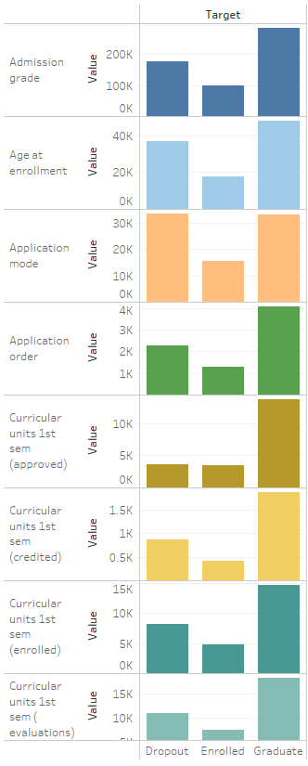
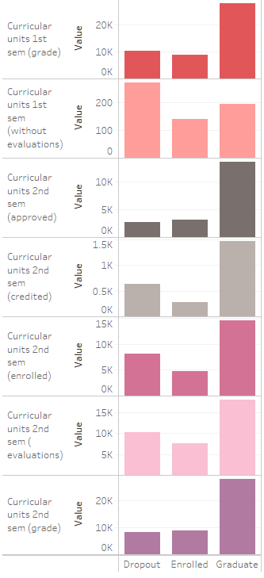
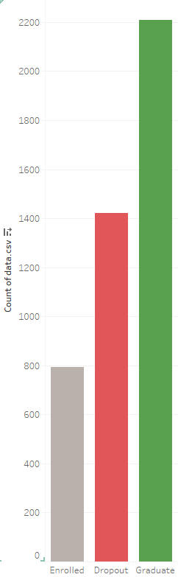
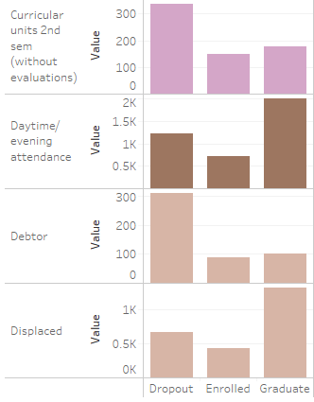
Data Exploratory

Slide 7
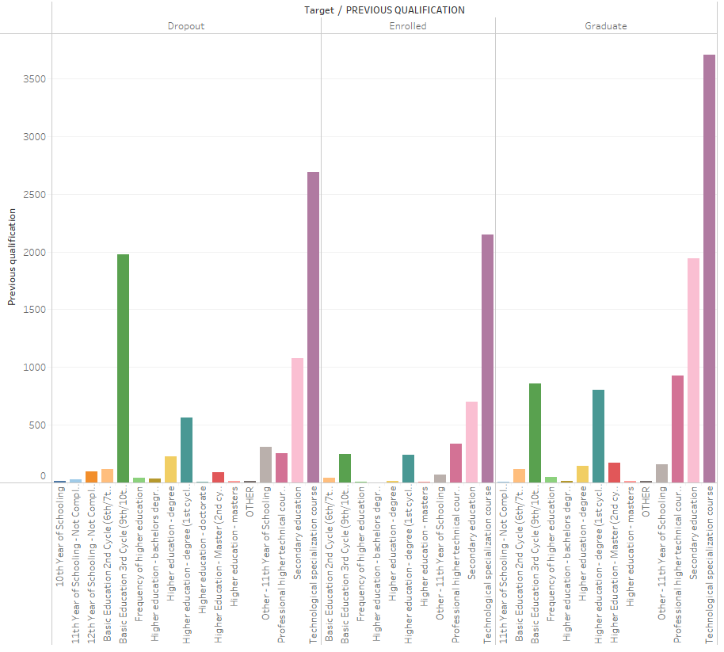

Previous qualifications:
Amount of education
Level of education
Completed or not
Target Audience:
Tech companies
School Administrators

Slide 8
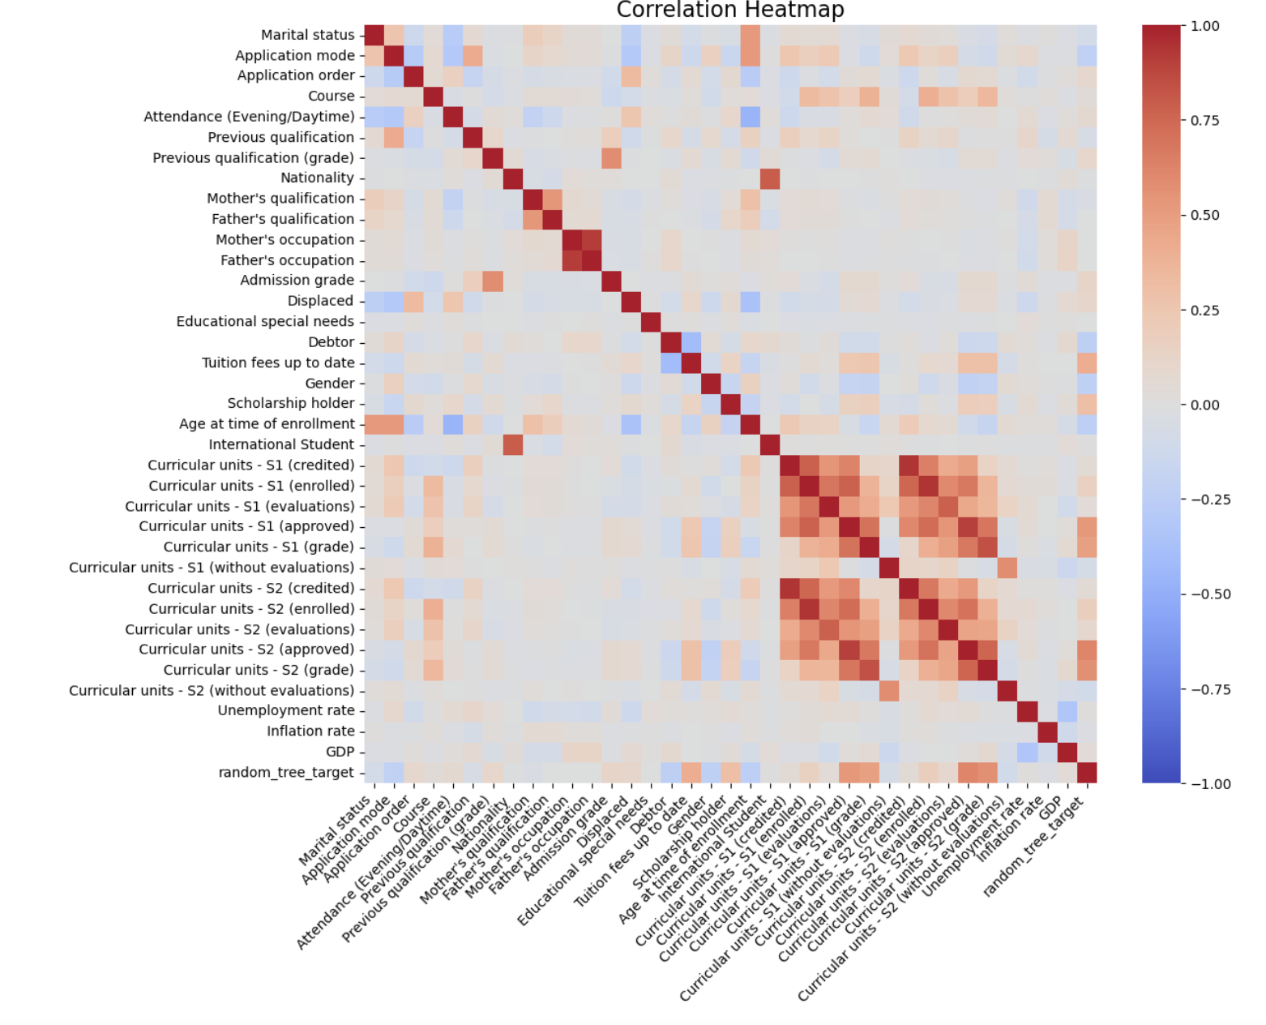
Feature Clusters Correlations
Strong Correlations
Curricular units - S1 and Curricular units - S2
Mild Correlations
Mother’s qualification, Father’s qualification, Occupation
Key Influencers on Student Performance
Admission grade: Strong
Previous qualification (grade): Mild
Tuition fees up to date: Mild

Slide 9
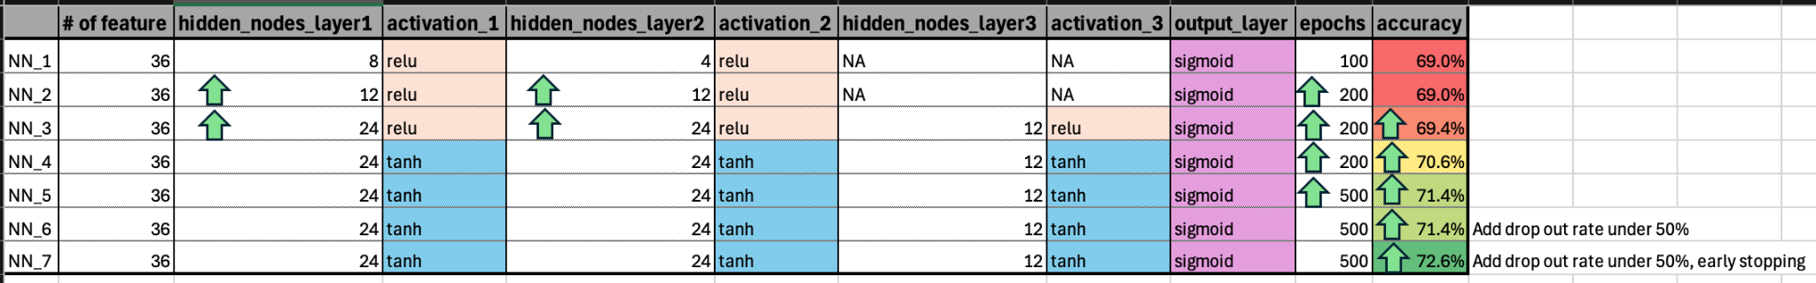

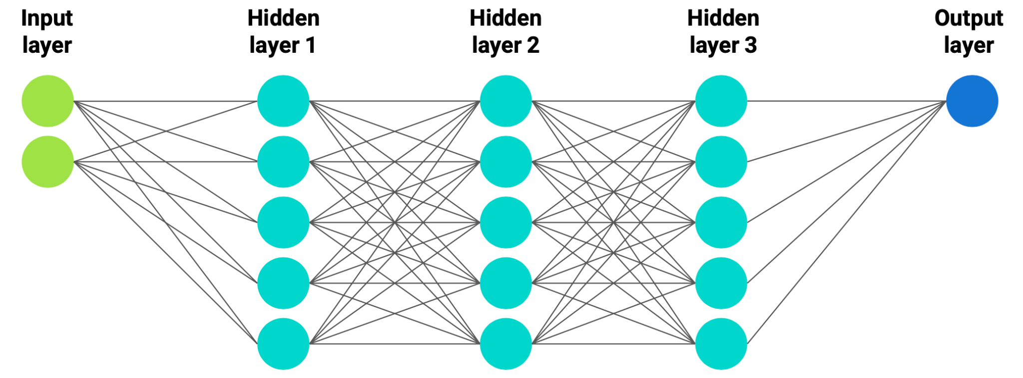
Neural Network

Slide 10
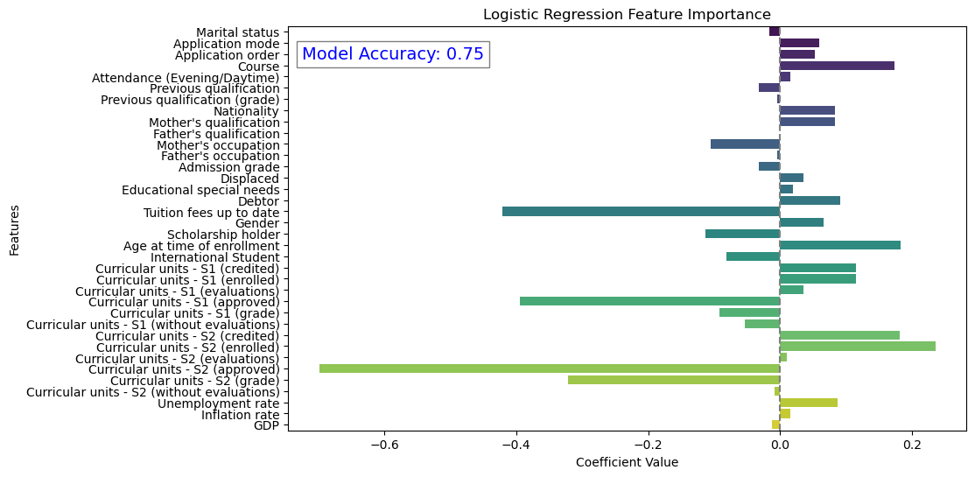
Logistic Regression

Slide 11
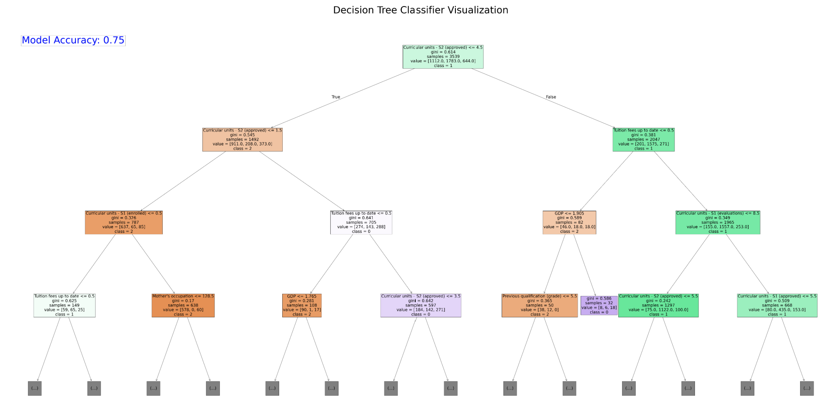
Decision Tree

Slide 12

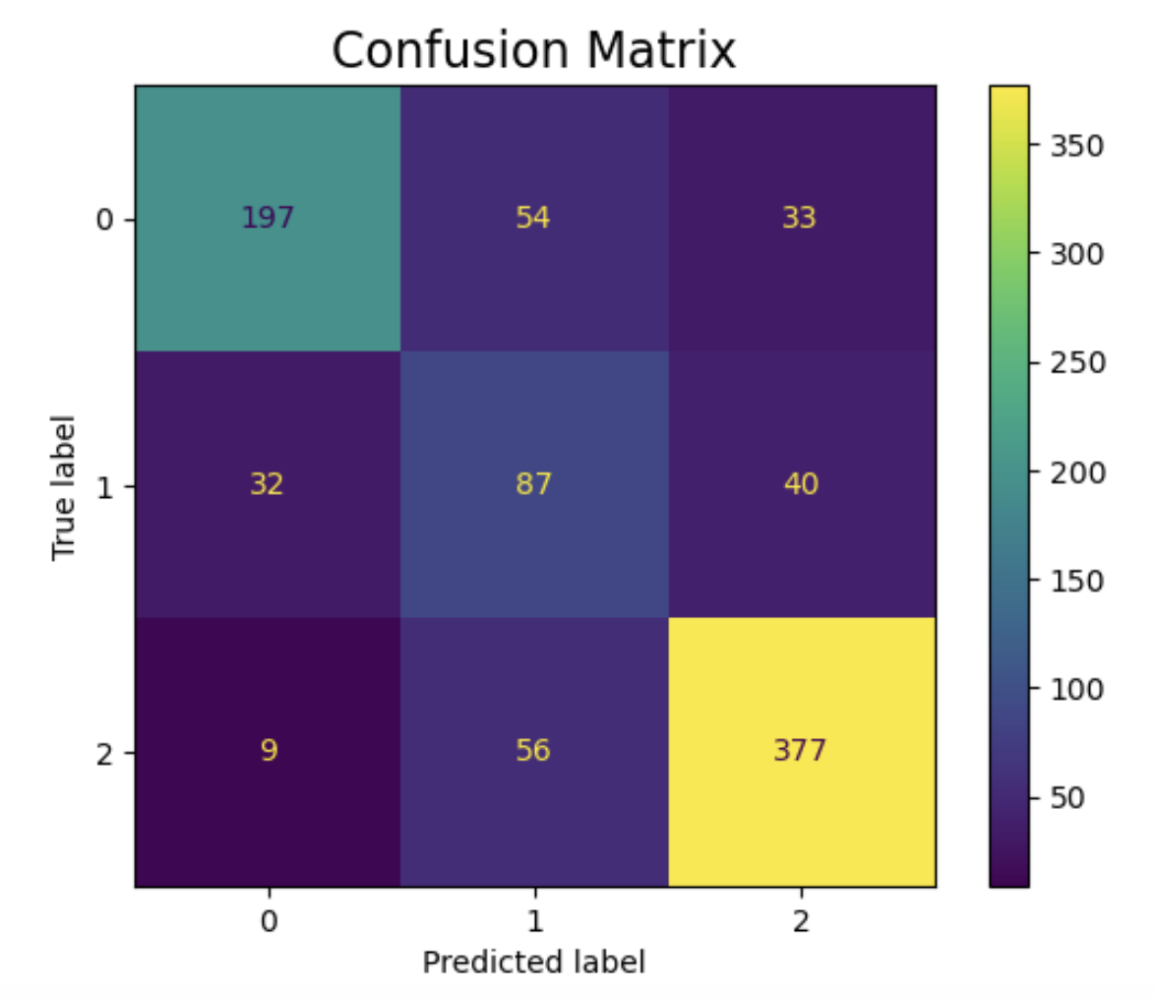
Overall Accuracy: 75%
Best Prediction: Graduates (Class 2)
377 correctly classified (85% recall).
Dropout Misclassification
54 Dropouts misclassified as Enrolled
33 Dropouts predicted as Graduates
Random Forest

Slide 13
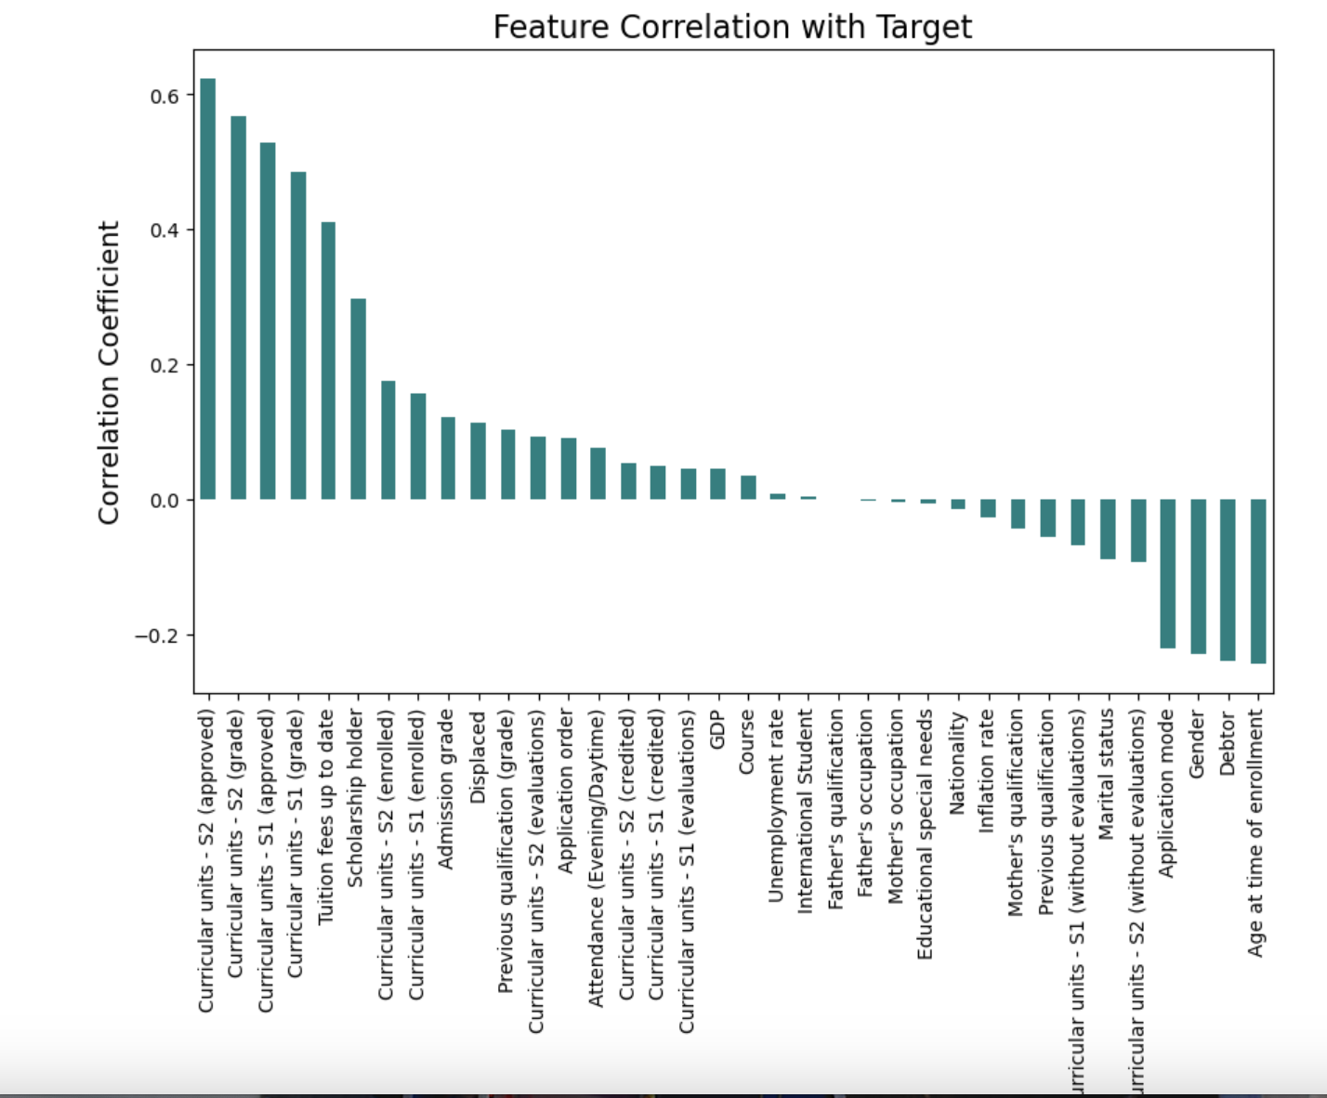
Random Forest
Strongest Predictors (Positive Correlation)
Curricular Units - S2 & S1 - Higher approval rates and grades in first and second semesters strongly correlate with academic success.
Higher admission grades positively correlate with better academic outcomes.
Negative Correlation (Risk Factors for Dropout)
Age at Time of Enrollment, Debtor Status, Gender: Older students & those with outstanding debt are at a higher risk of dropout.
Previous Qualification & Mother’s Qualification: Lower previous qualifications may indicate a weaker academic foundation, impacting retention.

Slide 14
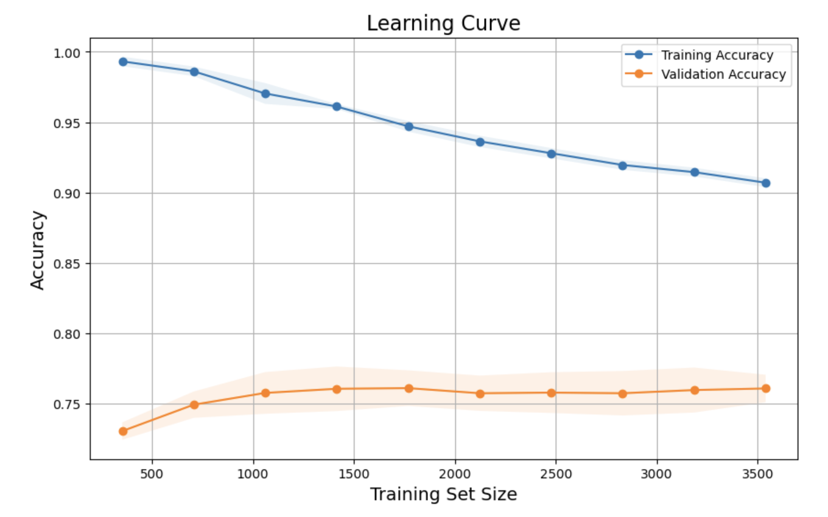

Random Forest
Training Accuracy
As the dataset size increases, training accuracy gradually decreases, stabilizing around 92%.
Validation Accuracy
The validation accuracy remains significantly lower than training accuracy.
The gap between training and validation accuracy suggests overfitting
Stability at Larger Dataset Sizes
validation accuracy plateaus (~75%)

Slide 15

 | Accuracy
Neural Network | 72%
Logistic Regression | 75%
Decision Tree | 75%
Random Forest | 75%
Conclusion
Model is not strong enough to predict an outcome

Slide 16
Collect data for new features
Calculate total credit hours taken per semester
Factor in financial situations
Credit Score / debt
Work or no work
Financial aid from family or no familial financial aid
Number of kids?
Reduce target outcome -> drop enrolled value
Accuracy would increase to 95%

